Slide 1
Modernizing SQL Server the Right Way
Speaker Name, Title, Company
Notes:
Use this slide as the title slide > if the title is very long, use the second option

Slide 2
Why upgrade?

Slide 3
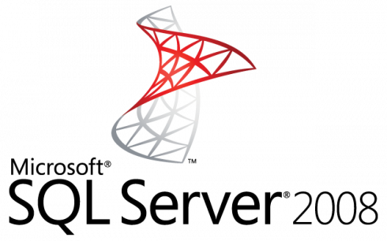
Winter is coming…
July 9, 2019
Notes:
July 9, 2019 – End of Support for SQL Server 2008 and 2008 R2
January 14, 2020 – End of Support for Windows Server 2008 and 2008 R2
https://www.microsoft.com/en-US/sql-server/sql-server-2008
For ESU on-premises offerings, see Customer FAQ and Internal Addendum on the EOS Learning site. Contact: esu2008@microsoft.com

Slide 4
Is it the right time to modernize?
Do I need to modernize to reduce costs?
To maintain compliance?
To keep vendor support?
For ISVs, to enable choice and features for my customers?
Can I separate application modernization cycles from data modernization cycles?
Notes:
As you may have observed, we released SQL 2016 about 24m after 2014, and 2017 about 16m after 2016. So there is a faster engineering cycle that's observable to meet market demands and pace of technology improvements. It really doesn't make sense that our customers would have to wait 2+ years to see innovations coming to their non-azure Data solutions, like it had happened historically.
End-customers and ISVs all face a fundamental and recurring question with their application and database estates: Is it the right time to modernize?
With that question come a number of considerations:
Do I need to modernize to reduce costs? To maintain required industry certification? To keep vendor support? For ISVs, to enable choice for my customers?
And how to minimize risk? Can I separate application modernization cycles from data modernization cycles?
And what’s my required certification process? What’s the cost of re-certifying for Azure SQL, or newer SQL Server version?

Slide 5
Database Compatibility Certification

Slide 6
Database Compatibility Level based certification
Stop certifying for any given platform (Cloud, on-prem)!
Stop certifying for a named SQL Server version!
Any certification process should be thought in terms of “which target database compatibility level am I certifying to?”
Updated public documentation: http://aka.ms/dbcompat
Notes:
We believe this paradigm shift unlocks agile modernization cycles and reduces upgrade risks.
And we are backing it up with actual engine level protections, as well as updated public documentation that moves in this direction: see http://aka.ms/dbcompat.

Slide 7
Key Benefits
Simplified application certification on-premise and Azure (e.g. Azure SQL DB MI).
Ability to provide customer a choice of latest SQL Server platform based on certified DB compat level.
Improved risk management by decoupling application upgrade cycles from Database upgrade cycles.

Slide 8
Microsoft stands by DB Compat based certification
Microsoft Database Compatibility Level Protection
Full Functional protection once assessment tools runs clean with no errors.
Query Plan shape protection on comparable hardware.
Maintaining backward compatibility is very important to SQL Server team.

Slide 9
Database Compatibility Level behavior
Product | Compatibility Level Designation | Supported Compatibility Level Values
SQL Server 2019 | 150 | 150, 140, 130, 120, 110, 100
SQL Server 2017 | 140 | 140, 130, 120, 110, 100
Azure SQL Database | 130 | 150, 140, 130, 120, 110, 100
SQL Server 2016 | 130 | 130, 120, 110, 100
SQL Server 2014 | 120 | 120, 110, 100
SQL Server 2012 | 110 | 110, 100, 90
SQL Server 2008 R2 | 100 | 100, 90, 80
SQL Server 2008 | 100 | 100, 90, 80
SQL Server 2005 | 90 | 90, 80
SQL Server 2000 | 80 | 80
Database Compatibility Level sets certain database behaviors to be compatible with the specified version of SQL Server.
Compatibility level affects behaviors only for the specified database, not for the entire server.
Notes:
New Databases are set to compatibility level mapping to the version of the Database Engine, unless the model database has a lower compatibility level.
When a database is upgraded from any earlier version of SQL Server, the database retains its existing compatibility level if it is at least minimum allowed for that instance of SQL Server.
Upgrading a database with a compatibility level lower than the allowed level, sets the database to the lowest compatibility level allowed.
Azure SQL Database V12 was released in December 2014. One aspect of that release was that newly created databases had their compatibility level set to 120. In 2015 SQL Database began support for level 130, although the default remained 120.
Starting in mid-June 2016, in SQL Database, the default compatibility level are 130 instead of 120 for newly created databases. Existing databases created before mid-June 2016 are not affected, and maintain their current compatibility level (100, 110, or 120).
If you want level 130 for your database generally, but you have reason to prefer the level 110 cardinality estimation algorithm, see ALTER DATABASE SCOPED CONFIGURATION (Transact-SQL), and in particular its keyword LEGACY_CARDINALITY_ESTIMATION = ON.
For details about how to assess the performance differences of your most important queries, between two compatibility levels on SQL Database, see Improved Query Performance with Compatibility Level 130 in Azure SQL Database.

Slide 10
Functional change protection Clarifying the caveats
Deprecated = avoid use in new development
Deprecated functionality introduced in a given SQL Server version is still protected by that compatibility level.
Discontinued = removed from product
Discontinued functionality introduced in a given SQL Server version is not protected by compatibility level.
Example of removed T-SQL syntax.
In SQL Server 2012 the fastfirstrow hint was removed.
Regardless of the compatibility level, the query below will produce error 321 (not a recognized table hints option): SELECT * FROM HumanResources.Employee WITH (FASTFIRSTROW);
Instead use: SELECT * FROM HumanResources.Employee OPTION (FAST = <n>);
Notes:
© Microsoft Corporation. All rights reserved. MICROSOFT MAKES NO WARRANTIES, EXPRESS, IMPLIED OR STATUTORY, AS TO THE INFORMATION IN THIS PRESENTATION.

Slide 11
Functional change protection Clarifying the caveats
Breaking Changes = behavior changes resulting in different outcome
Protected by Database Compatibility:
DECLARE @value datetime = '1900-01-01 00:00:00.003'
SELECT CAST(@value AS datetime2)
In DB Compat 120 or lower, result is: 1900-01-01 00:00:00.0030000
Under DB Compat 130, these show improved accuracy by accounting for the fractional milliseconds, resulting in: 1900-01-01 00:00:00.0033333
Not Protected by Database Compatibility:
The query below works until DB Compat 90, but errors out starting with Database Compatibility 100 (error 241, conversion fail): SELECT DATEPART (year, '2007/05-30’)
Instead use: SELECT DATEPART (year, '2007/05/30’) or SELECT DATEPART (year, '2007-05-30’)
Notes:
Until DB Compat 90, datetime intrinsics such as DATEPART do not require string input values to be valid datetime literals. For example, SELECT DATEPART (year, '2007/05-30') compiles successfully.
Starting with DB Compat 100, datetime intrinsics such as DATEPART require string input values to be valid datetime literals. Error 241 is returned when an invalid datetime literal is used.
© Microsoft Corporation. All rights reserved. MICROSOFT MAKES NO WARRANTIES, EXPRESS, IMPLIED OR STATUTORY, AS TO THE INFORMATION IN THIS PRESENTATION.

Slide 12
Upgrade Process

Slide 13
Minimize Risk with the Database Migration Guide
Functional & Performance tests
Remediate applications
Migrate schema, objects & data
Optimize
Discover
Assess
Convert
Data Sync
Cutover
Notes:
Migrations should be approached with the same rigor and processes as a full software or hardware project – a solid methodology is required for success. Microsoft provides you with all the tools you need to achieve a seamless, reliable upgrade experience.
Share the Database Migration Guide with your customers for step-by-step guidance on reliable upgrade methodology.
https://datamigration.microsoft.com/scenario/sql-to-sqlserver

Slide 14
Reliable Upgrades
Review the Database Migration Guide for details
“With tools like Database Migration Assistant and Database Experimentation Assistant, we were able to reduce the time and effort required for the upgrade, enable automated A/B testing capability to minimize risk and provide a high confidence upgrade plan for a mission critical, Tier-1 environment spanning over a 1000 instances of SQL Server within 3 months.”
Salesforce – PASS Summit 2017
Discover
Assess
Test
Microsoft Assessment and Planning Toolkit (MAP)
Database Migration Assistant (DMA)
Database Experimentation Assistant (DEA)
Fully automated using free tools from Microsoft
Notes:
Link in slide: https://datamigration.microsoft.com/scenario/sql-to-sqlserver
Source for quote?

Slide 15
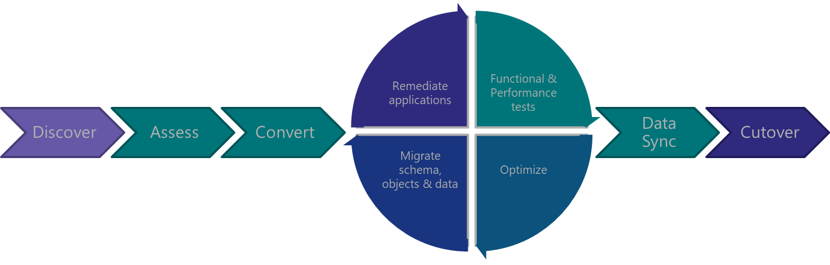
Discover

Slide 16
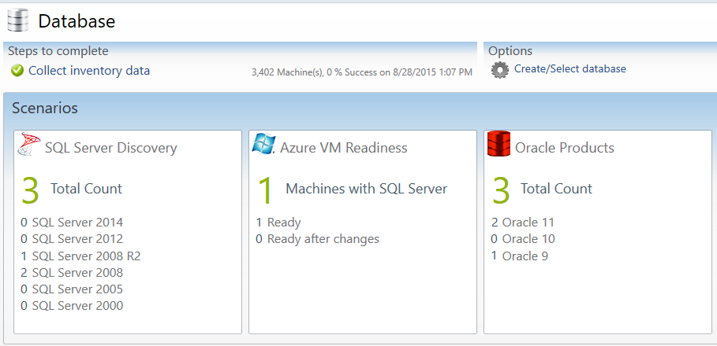
Discover with MAP Toolkit
Which SQL Server versions do I have?
Which Editions am I running?
Which SQL Server components are installed?
How many cores are on each server?
How many databases are in each instance?
What are the sizes of all my databases?
What are the settings for each instance and database?
Notes:
The Microsoft Assessment and Planning Toolkit (MAP) is an agentless, automated, multi-product planning and assessment tool for quicker and easier desktop, server and cloud migrations. MAP can be used to provide an inventory of all your database servers, including installed components, database details, settings and capacity planning information. This Solution Accelerator provides a powerful inventory, assessment, and reporting tool to simplify the migration planning process.
There are 8 areas that the Microsoft Assessment and Planning Toolkit (MAP) toolkit assesses:
Cloud
Desktop
Server
Desktop Virtualization
Server Virtualization
Database
Usage Tracking
Environment

Slide 17
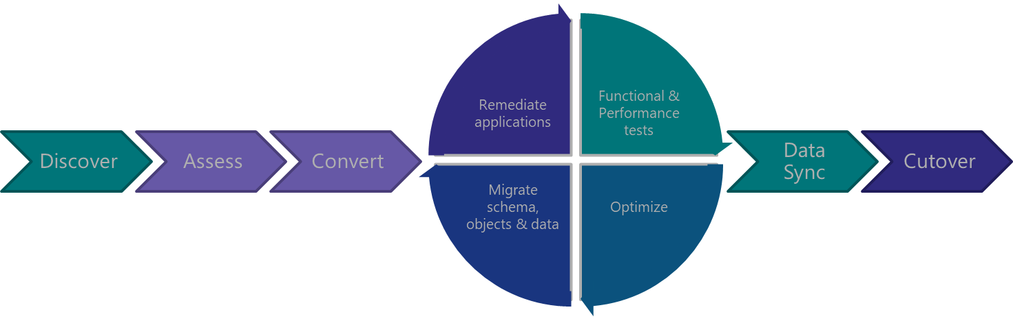
Assess & Convert

Slide 18

Assess & Convert with DMA
Breaking changes
Performance
Behavior changes
Deprecated features
Storage
Assess Compatibility Issues
Discover new features
Security
Perform Migration
Connect to source and target servers
Review final report
Choose databases
Monitor migration
“Upgrade readiness assessment was delivered with the help of Database Migration Assistant which helped us analyze our template databases to identify potential pitfalls and suggested automated remediation for our development teams to act on.”
Salesforce – PASS Summit 2017
Data Migration Assistant
Notes:
Data Migration Assistant (DMA) detects compatibility issues that can impact database functionality on your new version of SQL Server. It recommends performance and reliability improvements for your target environment. It allows you to not only move your schema and data, but also uncontained objects from your source server to your target server. Once the assessment is complete and issues have been mitigated, the DMA will automate the process of migrating your schema and data to the target instance.
Source for quote?

Slide 19
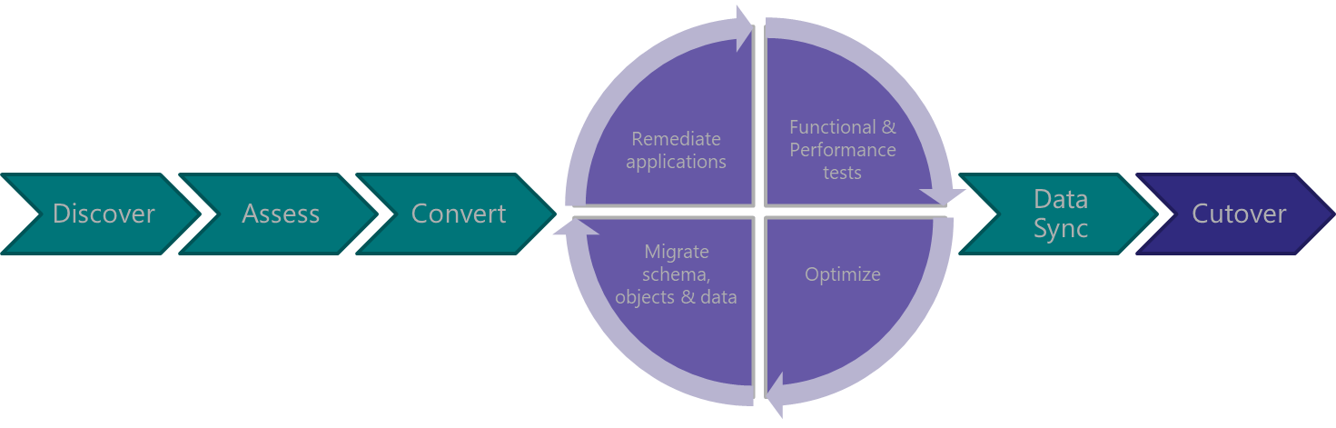
Test &
Optimize

Slide 20

Test & Optimize with DEA
Database Experimentation Assistant
A/B testing
Compatibility execution errors
Degraded queries
Workload comparison
Hardware comparison
Configuration setting comparison
“Database Experimentation Assistant helped us perform comparison tests between our current environment and a test SQL Server 2016 environment to identify regressions, breaking changes and performance characteristics.
Because of the automation, we were able to repeat such an exercise with multiple iterations using different configuration settings.”
Salesforce – PASS Summit 2017
Notes:
Database Experimentation Assistant (DEA) is an A/B testing solution for SQL Server upgrades. It will assist in evaluating a targeted version of SQL for a given workload. Customers who are upgrading from previous SQL Server versions (SQL Server 2005 and above) to any new version of the SQL Server will be able to use these analysis metrics.
DEA allows:
Automated script to set up workload capture and replay of production database (using existing SQL server functionality Distributed Replay & SQL tracing).
Perform statistical analysis on traces collected using both old and new instances.
Visualize data through detailed reports.
Source for quote?

Slide 21
Now with ad-hoc workload assessments!
Walkthrough
Database Migration Assistant

Slide 22
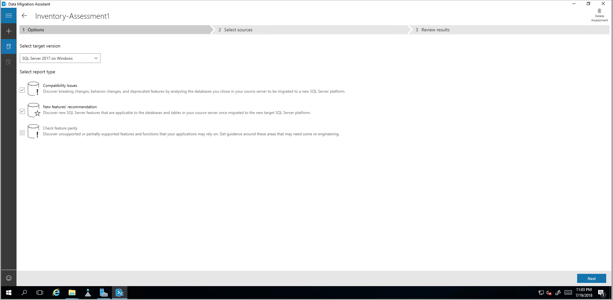
Notes:
DMA Assessment: Options

Slide 23
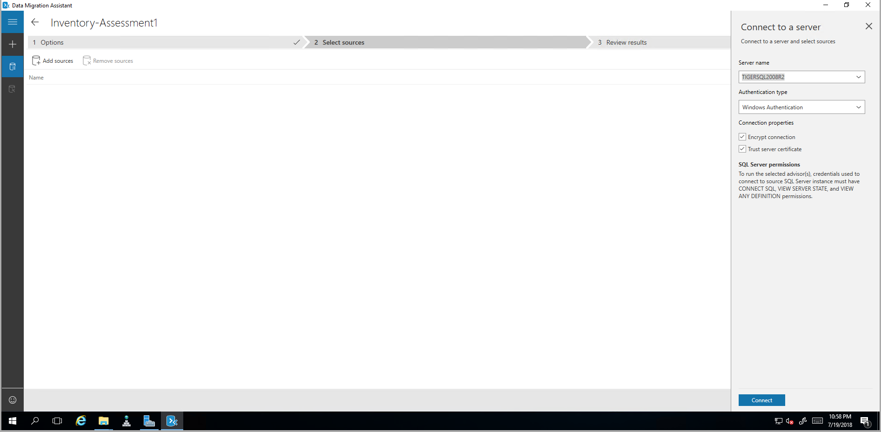
Notes:
DMA Assessment: Select Sources

Slide 24
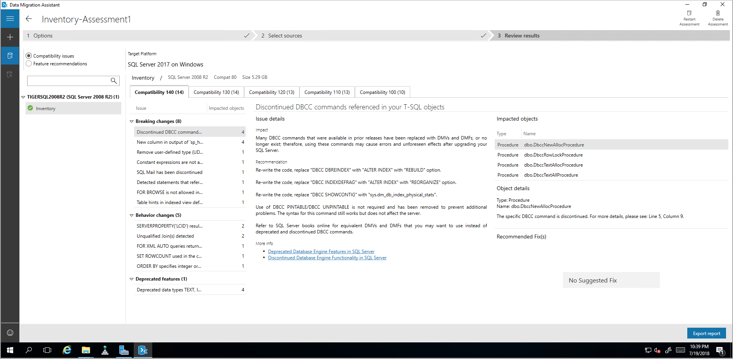
Notes:
DMA Assessment: Completed

Slide 25
Walkthrough
Database Experimentation Assistant

Slide 26
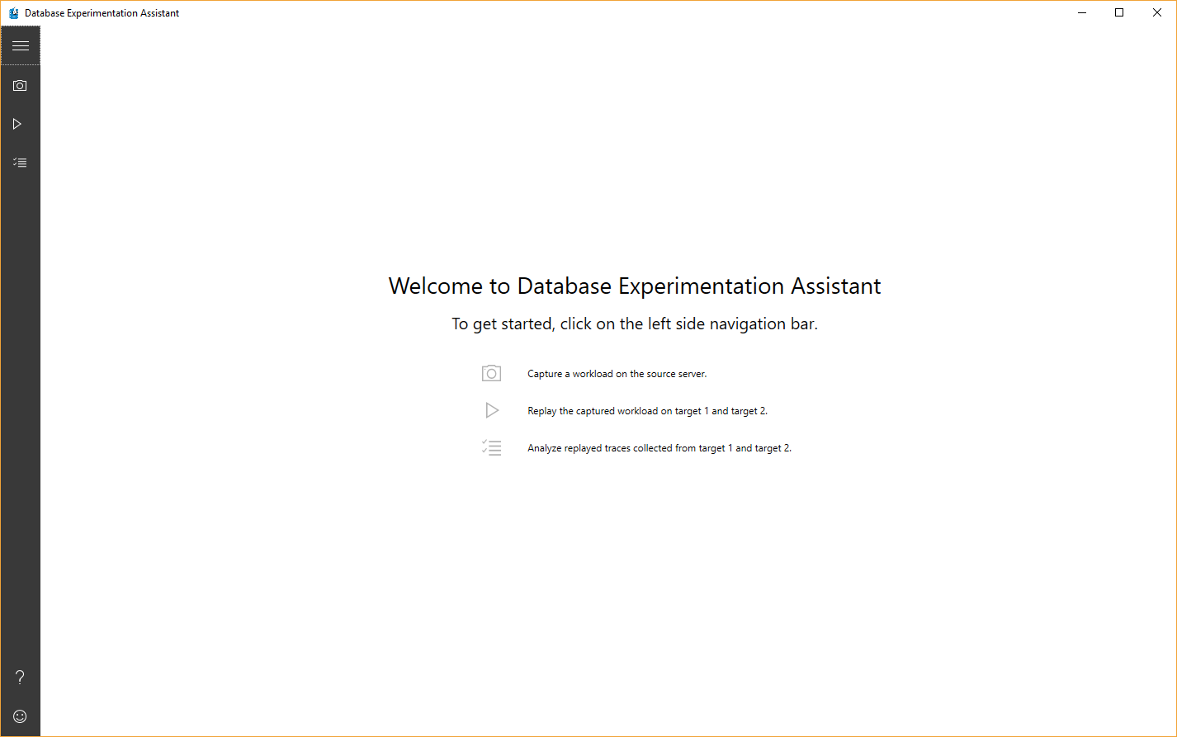
Notes:
After opening, click on “Analyze traces”

Slide 27
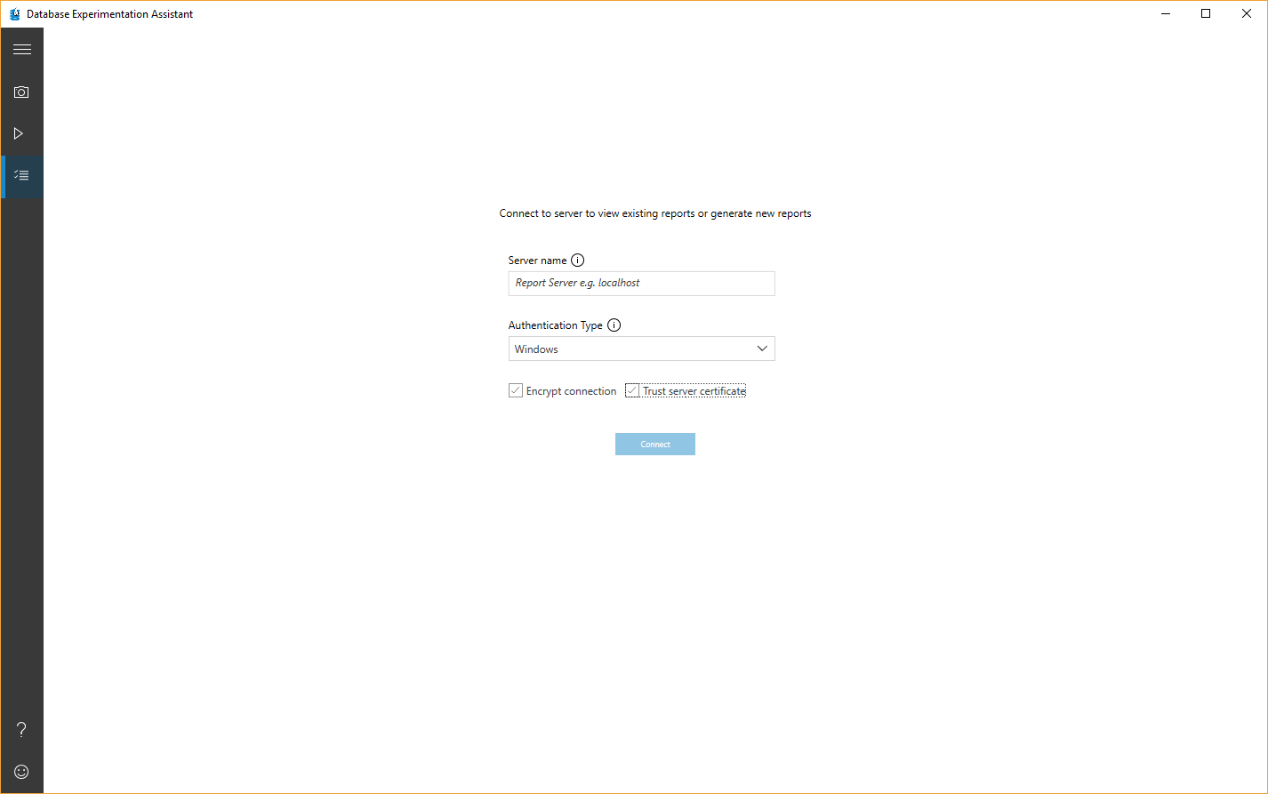
Notes:
Then input server (we’re using localhost) and we’re using the option to trust server cert.

Slide 28
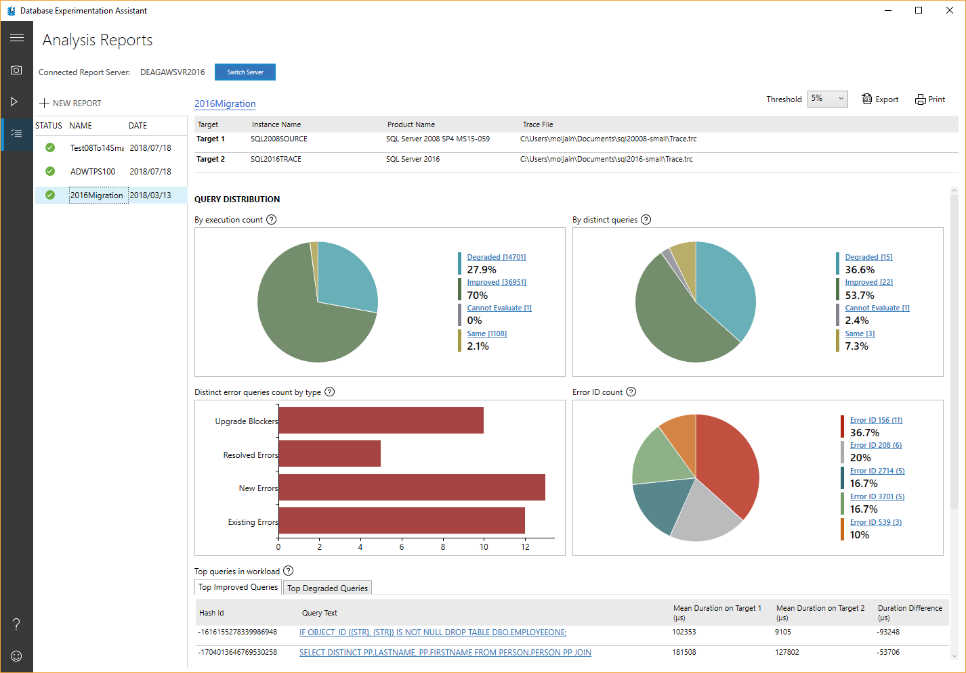
Notes:
Once we select one of the previous replays we’ve done, the report shows up.

Slide 29
Notes:
We see we have a number of potential upgrade blockers. Click on the bar to see details.

Slide 30
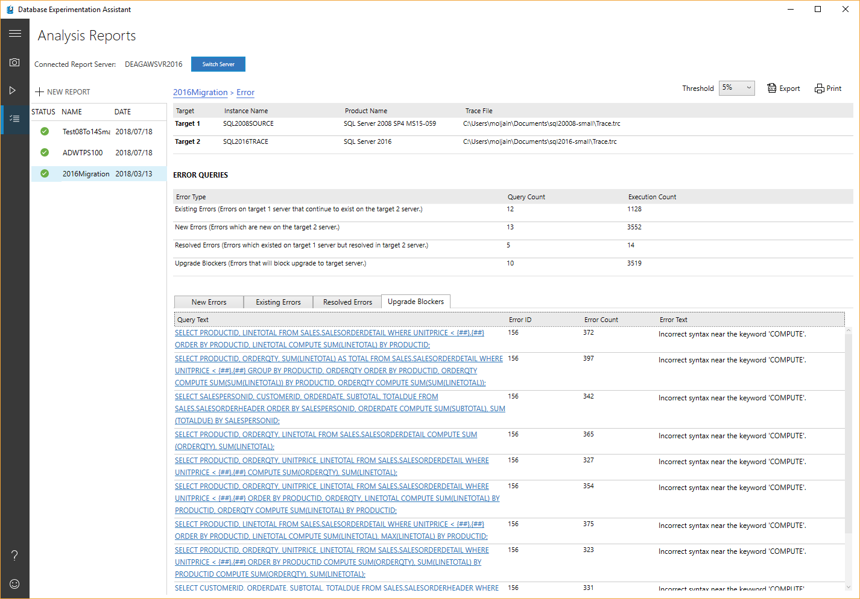
Notes:
The Upgrade Blockers tab shows any syntax execution errors that existed in the replay (B) that didn’t exist in the source (A). Syntax errors mapping to discontinued T-SQL are listed, in the context of the statement that produced the error. In this case, the “COMPUTE” clause was discontinued (back in SQL 2012), so this issue needs addressing.

Slide 31
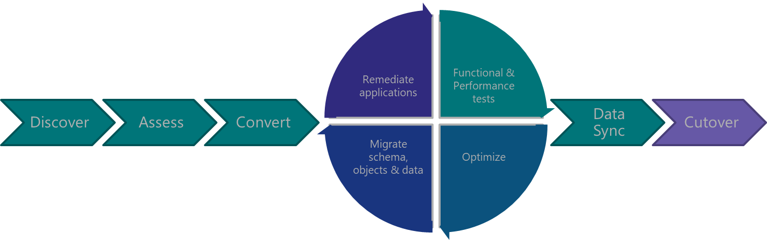
Post-
Migration

Slide 32
I moved the data, am I done?
SQL Server post migration step is very crucial for reconciling any data accuracy and completeness, as well as uncover performance issues with the workload.
Recommended Upgrade Plan for latest DB Compatibility Level:
Upgrade to latest SQL Server and keep source DB Compat level
Enable Query Store
Wait to collect data on the workload (create a baseline)
Set DB Compat Level to latest
Quickly fix regressions by forcing last known good plan
Notes:
Reference:
https://docs.microsoft.com/sql/relational-databases/performance/query-store-usage-scenarios#CEUpgrade

Slide 33
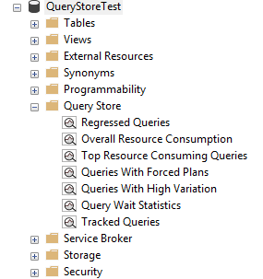
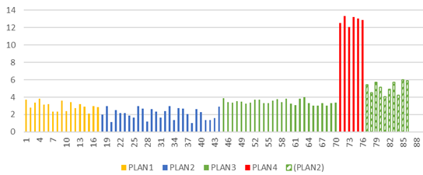
Upgrading DB Compat until recently
SQL 2016+
Query Store Regressed Queries
SQL 2017+
Automatic Plan Correction
Notes:
Identifies the problem query plan and “fixes” it to be optimal. In the scope of a DB Compatibility upgrade, only works if the recommended process was followed

Slide 34
Query Tuning Assistant (QTA)
1st Priority: to guide users through the documented and recommended DB Compatibility upgrade procedure with ease.
What if instead of choosing between current and last know good plan, we find a 3rd, better plan?
Upgrade to latest SQL Server and keep source DB Compat level
Enable Query Store
Wait to collect data on the workload (create a baseline)
Set DB Compat Level to latest
Quickly fix regressions by forcing last known good plan
Find a better plan through tuning
Notes:
Post-migration/upgrade
Crucial to uncover query performance issues with the workload, as it runs on the newer version of SQL Server Database Engine.
User needs to follow documented DB upgrade procedure (https://docs.microsoft.com/en-us/sql/relational-databases/performance/query-store-usage-scenarios#CEUpgrade).
User database is still in before-upgrade database compatibility level, and QTA will assist in collecting baseline workload data (if none available), bump database compatibility level, collect 2nd pass of workload data, and work on any regressions found based on “Regressed Queries” QS report.

Slide 35
Query Tuning Assistant (QTA) Workflow
Query Store Regressed Queries
Analysis and Recommendations
Correlation vs Independence ASSUME_MIN_SELECTIVITY_FOR_FILTER_ESTIMATES
Deployment via Plan Guide
As a last resort, full-fledge use of CE70 is also considered, when all else doesn’t yield desired results.
Simple vs Base Join Containment ASSUME_JOIN_PREDICATE_DEPENDS_ON_FILTERS
TVF fixed estimation of 100 rows vs 1 row ‘QUERYTRACEON 9488’
Available in SSMS v18 and Powershell (preview)
Notes:
Like any hint, it forces certain behaviors that may get addressed in subsequent updates. So Microsoft recommends you only apply hints when no other option exists, and plan to revisit hinted code with every new upgrade. By forcing behaviors, you may be precluding your workload from benefiting of enhancements introduced in newer versions.

Slide 36
Modernization Tools Breakdown
QTA
Upgrade Database Compatibility Model to desired state
Provides tangible recommendations for tuning queries without reverting DB compat
DMA
A/B Testing
Capture and Replay workload for performance testing and reporting
Also reports on migration blockers because of failed T-SQL syntax
Detects workload regressions, and tests CE model variations (subsets)
Readiness assessment: blocking issues breaking changes, behavior changes
Moves schema, data and uncontained objects (like logins) To Azure SQL Database
Backup / Restore to another SQL Server (Keeps source DB Compatibility Level)
DEA
New feature recommendation
Notes:
DMA
https://docs.microsoft.com/en-us/sql/dma/dma-assesssqlonprem
https://docs.microsoft.com/en-us/sql/dma/dma-overview
New feature recommendations include In-Memory OLTP and Columnstore, Stretch Database, Always Encrypted, Dynamic Data Masking, and Transparent Data Encryption.
DEA
Database Experimentation Assistant (DEA) is an A/B testing solution for changes in SQL Server environments (e.g. upgrade, new indexes, etc.). It assists in evaluating how the workload on your source server (current environment) will perform against your new environment. It guides you through performing an A/B test through three steps: capture, replay, and analysis.
QTA
Query Tuning Assistant (QTA) helps address some of the most common causes of CE-related performance regression, namely the following model assumption changes, starting with SQL Server 2014:
Independence vs Correlation
Simple Containment vs Base Containment
TVF fixed estimation of 100 rows vs 1 row
Note: as a last resort, full-fledge use of CE 70 is also considered, when all else doesn’t yield desired results.
This is done by attempting to use targeted USE HINT query hints that change these assumptions, for regressed SELECT-based queries.

Slide 37
Demo
Query Tuning Assistant

Slide 38
Session takeaways
Start planning for End of Service for SQL Server 2008/R2 and Windows Server 2008/R2 today!
Review the database migration guide
Familiarize yourself with the DMA, DEA, Query Store and Query Tuning Assistant
Leverage Database Compatibility to accelerate modernization

Slide 39
Session resources
http://aka.ms/sqleosfaq - End-of-Support FAQ
Upgrade SQL Server
Database Migration Guide
Microsoft Assessment and Planning Toolkit
Overview of Data Migration Assistant
DEA 2.1 General Availability: Release Overview – Database Experimentation Assistant
Post-migration Validation and Optimization Guide
http://aka.ms/dbcompat (DB Compatibility Level based upgrades)

Slide 40
Questions?

Slide 41
Thank You

